Slide 1
Chapter 19 – Data Structures
Outline
19.1 Introduction
19.2 Self-Referential Classes
19.3 Dynamic Memory Allocation
19.4 Linked Lists
19.5 Stacks
19.6 Queues
19.7 Trees

Slide 2
19.1 Introduction
Dynamic data structures
  Grow and shrink at execution time
  Several types
    Linked lists
    Stacks
    Queues
    Binary trees

Slide 3
19.2 Self-Referential Classes
Self-referential class
  Contains instance variable referring to object of same class
    class Node {
    private int data;
    private Node nextNode;
    // constructors and methods ...
    }
    Member nextNode is a link
      nextNode “links” a Node object to another Node object

Slide 4

19.2 Self-Referential Classes (cont.)
Fig 19.1 Two self-referential class objects linked together.

Slide 5
19.3 Dynamic Memory Allocation
Dynamic memory allocation
  Obtain more memory at execution time to store new objects
    Operator new
  Release memory used by objects when no longer needed

Slide 6
19.4 Linked Lists
Linked list
  Linear collection of self-referential classes (nodes)
  Connected by reference links
  Nodes can be inserted and deleted anywhere in linked list
  Last node is set to null to mark end of list

Slide 7
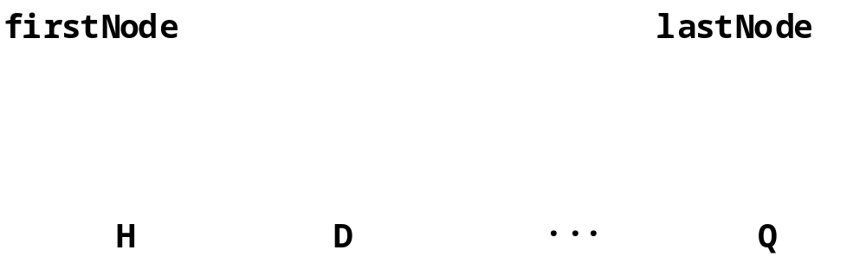
19.4 Linked Lists (cont.)
Fig 19.2 A graphical representation of a linked list.

Slide 8
List.java
Lines 6-10
1 // Fig. 19.3: List.java
2 // Class ListNode and class List definitions
3 package com.deitel.jhtp4.ch19;
4
5 // class to represent one node in a list
6 class ListNode {
7
8 // package access members; List can access these directly
9 Object data;
10 ListNode nextNode;
11
12 // constructor to create a ListNode that refers to object
13 ListNode( Object object )
14 {
15 this( object, null );
16 }
17
18 // constructor to create ListNode that refers to Object
19 // and to next ListNode in List
20 ListNode( Object object, ListNode node )
21 {
22 data = object;
23 nextNode = node;
24 }
25
26 // return Object in this node
27 Object getObject()
28 {
29 return data;
30 }
31
Self-referential class ListNode contains data and link to nextNode

Slide 9
List.java (Part 2)
Line 42
Line 43
Line 50
Lines 64-65
32 // get next node
33 ListNode getNext()
34 {
35 return nextNode;
36 }
37
38 } // end class ListNode
39
40 // class List definition
41 public class List {
42 private ListNode firstNode;
43 private ListNode lastNode;
44 private String name; // String like "list" used in printing
45
46 // construct an empty List with a name
47 public List( String string )
48 {
49 name = string;
50 firstNode = lastNode = null;
51 }
52
53 // construct empty List with "list" as the name
54 public List()
55 {
56 this( "list" );
57 }
58
59 // Insert Object at front of List. If List is empty,
60 // firstNode and lastNode will refer to same object.
61 // Otherwise, firstNode refers to new node.
62 public synchronized void insertAtFront( Object insertItem )
63 {
64 if ( isEmpty() )
65 firstNode = lastNode = new ListNode( insertItem );
66
Reference to first node in linked list
Reference to last node in linked list
First and last nodes in empty list are null
If list is empty, the first and last node should refer to the newly inserted node

Slide 10
List.java (Part 3)
Line 68
Lines 76-77
Lines 80-81
Lines 91-92
67 else
68 firstNode = new ListNode( insertItem, firstNode );
69 }
70
71 // Insert Object at end of List. If List is empty,
72 // firstNode and lastNode will refer to same Object.
73 // Otherwise, lastNode's nextNode refers to new node.
74 public synchronized void insertAtBack( Object insertItem )
75 {
76 if ( isEmpty() )
77 firstNode = lastNode = new ListNode( insertItem );
78
79 else
80 lastNode = lastNode.nextNode =
81 new ListNode( insertItem );
82 }
83
84 // remove first node from List
85 public synchronized Object removeFromFront()
86 throws EmptyListException
87 {
88 Object removeItem = null;
89
90 // throw exception if List is empty
91 if ( isEmpty() )
92 throw new EmptyListException( name );
93
94 // retrieve data being removed
95 removeItem = firstNode.data;
96
97 // reset the firstNode and lastNode references
98 if ( firstNode == lastNode )
99 firstNode = lastNode = null;
100
If list is not empty, the first node should refer to the newly inserted node
If list is empty, the first and last node should refer to the newly inserted node
If list is not empty, the last node should refer to the newly inserted node
If list is empty, removing a node causes an exception

Slide 11
List.java (Part 4)
Line 102
Lines 131-137
101 else
102 firstNode = firstNode.nextNode;
103
104 // return removed node data
105 return removeItem;
106 }
107
108 // Remove last node from List
109 public synchronized Object removeFromBack()
110 throws EmptyListException
111 {
112 Object removeItem = null;
113
114 // throw exception if List is empty
115 if ( isEmpty() )
116 throw new EmptyListException( name );
117
118 // retrieve data being removed
119 removeItem = lastNode.data;
120
121 // reset firstNode and lastNode references
122 if ( firstNode == lastNode )
123 firstNode = lastNode = null;
124
125 else {
126
127 // locate new last node
128 ListNode current = firstNode;
129
130 // loop while current node does not refer to lastNode
131 while ( current.nextNode != lastNode )
132 current = current.nextNode;
133
If list is empty, removing a node causes an exception
If list is not empty, the second-to-last node becomes the last node

Slide 12
List.java (Part 5)
Lines 162-165
134 // current is new lastNode
135 lastNode = current;
136 current.nextNode = null;
137 }
138
139 // return removed node data
140 return removeItem;
141 }
142
143 // return true if List is empty
144 public synchronized boolean isEmpty()
145 {
146 return firstNode == null;
147 }
148
149 // output List contents
150 public synchronized void print()
151 {
152 if ( isEmpty() ) {
153 System.out.println( "Empty " + name );
154 return;
155 }
156
157 System.out.print( "The " + name + " is: " );
158
159 ListNode current = firstNode;
160
161 // while not at end of list, output current node's data
162 while ( current != null ) {
163 System.out.print( current.data.toString() + " " );
164 current = current.nextNode;
165 }
166
Traverse list and print node values

Slide 13
List.java (Part 6)
167 System.out.println( "\n" );
168 }
169
170 } // end class List
167 System.out.println( "\n" );
168 }
169
170 } // end class List

Slide 14
EmptyListException.java
Lines 5-13
1 // Fig. 19.4: EmptyListException.java
2 // Class EmptyListException definition
3 package com.deitel.jhtp4.ch19;
4
5 public class EmptyListException extends RuntimeException {
6
7 // initialize an EmptyListException
8 public EmptyListException( String name )
9 {
10 super( "The " + name + " is empty" );
11 }
12
13 } // end class EmptyListException
Exception thrown when program attempts to remove node from empty list

Slide 15
ListTest.java
Line 13
Lines 16-19
Lines 22-29
1 // Fig. 19.5: ListTest.java
2 // Class ListTest
3
4 // Deitel packages
5 import com.deitel.jhtp4.ch19.List;
6 import com.deitel.jhtp4.ch19.EmptyListException;
7
8 public class ListTest {
9
10 // test class List
11 public static void main( String args[] )
12 {
13 List list = new List(); // create the List container
14
15 // create objects to store in List
16 Boolean bool = Boolean.TRUE;
17 Character character = new Character( '$' );
18 Integer integer = new Integer( 34567 );
19 String string = "hello";
20
21 // use List insert methods
22 list.insertAtFront( bool );
23 list.print();
24 list.insertAtFront( character );
25 list.print();
26 list.insertAtBack( integer );
27 list.print();
28 list.insertAtBack( string );
29 list.print();
30
31 // use List remove methods
32 Object removedObject;
33
Create linked list
Create values (Objects) to store in linked-list nodes
Insert values in linked list

Slide 16
ListTest.java (Part 2)
Lines 36-54
34 // remove objects from list; print after each removal
35 try {
36 removedObject = list.removeFromFront();
37 System.out.println(
38 removedObject.toString() + " removed" );
39 list.print();
40
41 removedObject = list.removeFromFront();
42 System.out.println(
43 removedObject.toString() + " removed" );
44 list.print();
45
46 removedObject = list.removeFromBack();
47 System.out.println(
48 removedObject.toString() + " removed" );
49 list.print();
50
51 removedObject = list.removeFromBack();
52 System.out.println(
53 removedObject.toString() + " removed" );
54 list.print();
55 }
56
57 // process exception if List is empty when attempt is
58 // made to remove an item
59 catch ( EmptyListException emptyListException ) {
60 emptyListException.printStackTrace();
61 }
62
63 } // end method main
64
65 } // end class ListTest
Remove values from linked list

Slide 17
ListTest.java (Part 3)
Program Output
The list is: true
The list is: $ true
The list is: $ true 34567
The list is: $ true 34567 hello
$ removed
The list is: true 34567 hello
true removed
The list is: 34567 hello
hello removed
The list is: 34567
34567 removed
Empty list

Slide 18
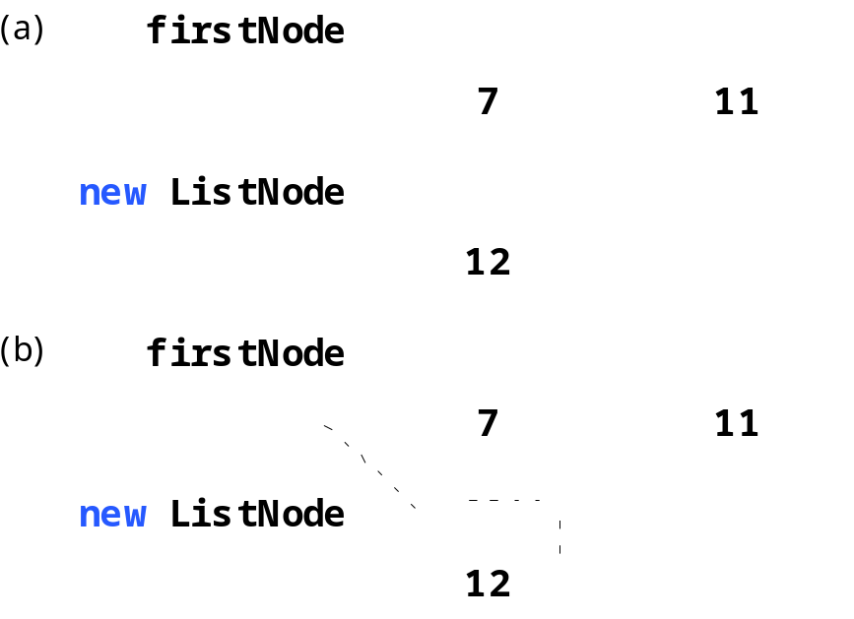
19.4 Linked Lists (cont.)
Fig 19.6 The insertAtFront operation.

Slide 19
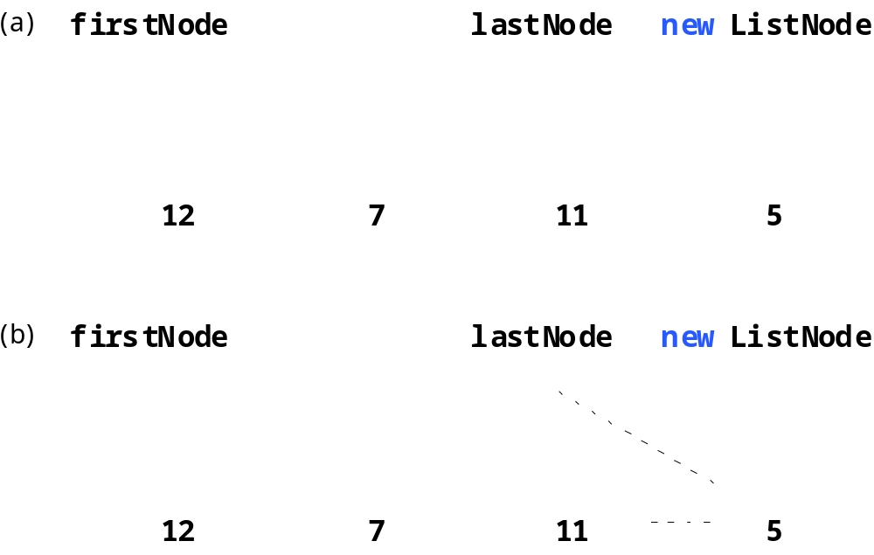
19.4 Linked Lists (cont.)
Fig 19.7 A graphical representation of the insertAtBack operation.

Slide 20
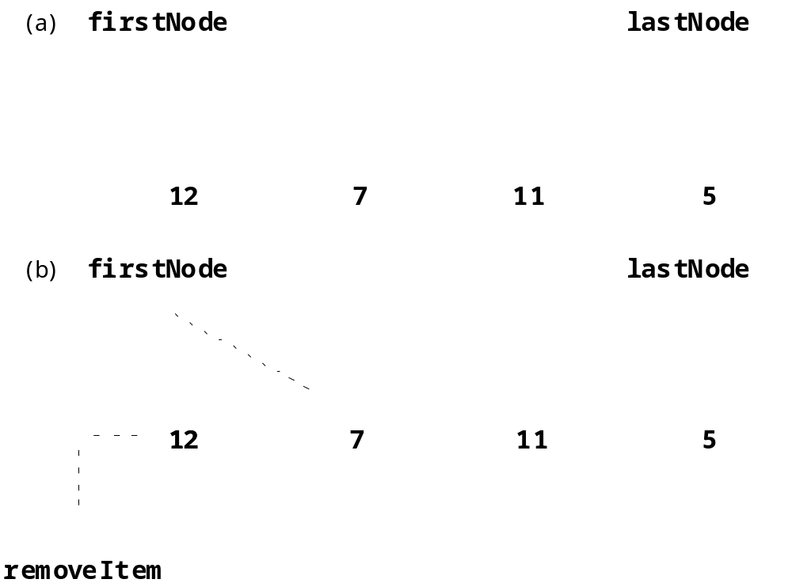
19.4 Linked Lists (cont.)
Fig 19.8 A graphical representation of the removeFromFront operation.

Slide 21
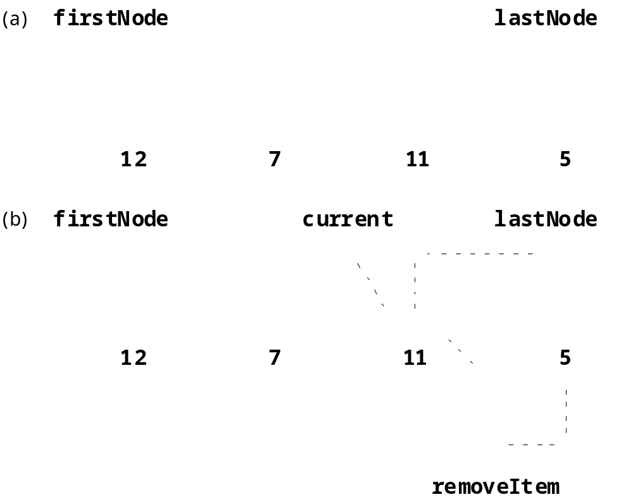
19.4 Linked Lists (cont.)
Fig 19.9 A graphical representation of the removeFromBack operation.

Slide 22
19.5 Stacks
Stack
  Constrained version of a linked list
    Add and remove nodes only to and from the top of the stack
      Push method adds node to top of stack
      Pop method removes node from top of stack

Slide 23
StackInheritance.java
Line 5
Lines 14-17
Lines 20-23
1 // Fig. 19.10: StackInheritance.java
2 // Derived from class List
3 package com.deitel.jhtp4.ch19;
4
5 public class StackInheritance extends List {
6
7 // construct stack
8 public StackInheritance()
9 {
10 super( "stack" );
11 }
12
13 // add object to stack
14 public synchronized void push( Object object )
15 {
16 insertAtFront( object );
17 }
18
19 // remove object from stack
20 public synchronized Object pop() throws EmptyListException
21 {
22 return removeFromFront();
23 }
24
25 } // end class StackInheritance
StackInheritance inherits from List, because a stack is a constrained version of a linked list
Method push adds node to top of stack
Method pop removes node from top of stack

Slide 24
StackInheritanceTest.java
Line 13
Lines 16-19
Lines 22-29
1 // Fig. 19.11: StackInheritanceTest.java
2 // Class StackInheritanceTest
3
4 // Deitel packages
5 import com.deitel.jhtp4.ch19.StackInheritance;
6 import com.deitel.jhtp4.ch19.EmptyListException;
7
8 public class StackInheritanceTest {
9
10 // test class StackInheritance
11 public static void main( String args[] )
12 {
13 StackInheritance stack = new StackInheritance();
14
15 // create objects to store in the stack
16 Boolean bool = Boolean.TRUE;
17 Character character = new Character( '$' );
18 Integer integer = new Integer( 34567 );
19 String string = "hello";
20
21 // use push method
22 stack.push( bool );
23 stack.print();
24 stack.push( character );
25 stack.print();
26 stack.push( integer );
27 stack.print();
28 stack.push( string );
29 stack.print();
30
31 // remove items from stack
32 try {
33
34 // use pop method
35 Object removedObject = null;
Create stack
Create values (Objects) to store in stack
Insert values in stack

Slide 25
StackInheritanceTest.java
(Part 2)
Line 38
36
37 while ( true ) {
38 removedObject = stack.pop();
39 System.out.println( removedObject.toString() +
40 " popped" );
41 stack.print();
42 }
43 }
44
45 // catch exception if stack empty when item popped
46 catch ( EmptyListException emptyListException ) {
47 emptyListException.printStackTrace();
48 }
49
50 } // end method main
51
52 } // end class StackInheritanceTest
Remove value from stack

Slide 26
StackInheritanceTest.java
(Part 3)
Program Output
The stack is: true
The stack is: $ true
The stack is: 34567 $ true
The stack is: hello 34567 $ true
hello popped
The stack is: 34567 $ true
34567 popped
The stack is: $ true
$ popped
The stack is: true
true popped
Empty stack
com.deitel.jhtp4.ch19.EmptyListException: The stack is empty
at com.deitel.jhtp4.ch19.List.removeFromFront(List.java:92)
at com.deitel.jhtp4.ch19.StackInheritance.pop(
StackInheritance.java:22)
at StackInheritanceTest.main(StackInheritanceTest.java:38)

Slide 27
StackComposition.java
Lines 5-6
Lines 15-18
Lines 21-24
1 // Fig. 19.12: StackComposition.java
2 // Class StackComposition definition with composed List object
3 package com.deitel.jhtp4.ch19;
4
5 public class StackComposition {
6 private List stackList;
7
8 // construct stack
9 public StackComposition()
10 {
11 stackList = new List( "stack" );
12 }
13
14 // add object to stack
15 public synchronized void push( Object object )
16 {
17 stackList.insertAtFront( object );
18 }
19
20 // remove object from stack
21 public synchronized Object pop() throws EmptyListException
22 {
23 return stackList.removeFromFront();
24 }
25
26 // determine if stack is empty
27 public synchronized boolean isEmpty()
28 {
29 return stackList.isEmpty();
30 }
31
Demonstrate how to create stack via composition
Method push adds node to top of stack
Method pop removes node from top of stack

Slide 28
StackComposition.java (Part 2)
32 // output stack contents
33 public synchronized void print()
34 {
35 stackList.print();
36 }
37
38 } // end class StackComposition

Slide 29
19.6 Queues
Queue
  Similar to a supermarket checkout line
  Nodes inserted only at tail (back)
    Method enqueue
  Nodes removed only from head (front)
    Method dequeue

Slide 30
QueueInheritance.java
Lines 16-19
Lines 22-25
1 // Fig. 19.13: QueueInheritance.java
2 // Class QueueInheritance extends class List
3
4 // Deitel packages
5 package com.deitel.jhtp4.ch19;
6
7 public class QueueInheritance extends List {
8
9 // construct queue
10 public QueueInheritance()
11 {
12 super( "queue" );
13 }
14
15 // add object to queue
16 public synchronized void enqueue( Object object )
17 {
18 insertAtBack( object );
19 }
20
21 // remove object from queue
22 public synchronized Object dequeue() throws EmptyListException
23 {
24 return removeFromFront();
25 }
26
27 } // end class QueueInheritance
Method enqueue adds node to top of stack
Method dequeue removes node from top of stack

Slide 31
QueueInheritanceTest.java
Line 13
Lines 16-19
Lines 22-29
1 // Fig. 19.14: QueueInheritanceTest.java
2 // Class QueueInheritanceTest
3
4 // Deitel packages
5 import com.deitel.jhtp4.ch19.QueueInheritance;
6 import com.deitel.jhtp4.ch19.EmptyListException;
7
8 public class QueueInheritanceTest {
9
10 // test class QueueInheritance
11 public static void main( String args[] )
12 {
13 QueueInheritance queue = new QueueInheritance();
14
15 // create objects to store in queue
16 Boolean bool = Boolean.TRUE;
17 Character character = new Character( '$' );
18 Integer integer = new Integer( 34567 );
19 String string = "hello";
20
21 // use enqueue method
22 queue.enqueue( bool );
23 queue.print();
24 queue.enqueue( character );
25 queue.print();
26 queue.enqueue( integer );
27 queue.print();
28 queue.enqueue( string );
29 queue.print();
30
31 // remove objects from queue
32 try {
33
34 // use dequeue method
35 Object removedObject = null;
Create queue
Create values (Objects) to store in queue
Insert values in queue

Slide 32
QueueInheritanceTest.java (Part 2)
Line 38
36
37 while ( true ) {
38 removedObject = queue.dequeue();
39 System.out.println( removedObject.toString() +
40 " dequeued" );
41 queue.print();
42 }
43 }
44
45 // process exception if queue empty when item removed
46 catch ( EmptyListException emptyListException ) {
47 emptyListException.printStackTrace();
48 }
49
50 } // end method main
51
52 } // end class QueueInheritanceTest
Remove value from queue
The queue is: true
The queue is: true $
The queue is: true $ 34567
The queue is: true $ 34567 hello
true dequeued
The queue is: $ 34567 hello

Slide 33
QueueInheritanceTest.java (Part 3)
$ dequeued
The queue is: 34567 hello
34567 dequeued
The queue is: hello
hello dequeued
Empty queue
com.deitel.jhtp4.ch19.EmptyListException: The queue is empty
at com.deitel.jhtp4.ch19.List.removeFromFront(List.java:92)
at com.deitel.jhtp4.ch19.QueueInheritance.dequeue(
QueueInheritance.java:24)
at QueueInheritanceTest.main(QueueInheritanceTest.java:38)

Slide 34
19.7 Trees
Tree
  Non-linear, two-dimensional data structure
    (unlike linked lists, stacks and queues)
  Nodes contain two or more links
  Root node is the first node
  Each link refers to a child
    Left child is the first node in left subtree
    Right child is the first node in right subtree
    Children of a specific node is siblings
    Nodes with no children are leaf nodes

Slide 35
19.7 Trees (cont.)
Binary search tree
  Special ordering of nodes
    Values in left subtrees are less than values in right subtrees
  Inorder traversal
    Traverse left subtree, obtain node value, traverse right subtree
  Preorder traversal
    Obtain node value, traverse left subtree, traverse right subtree
  Postorder traversal
    Traverse left subtree, traverse right subtree, obtain node value

Slide 36
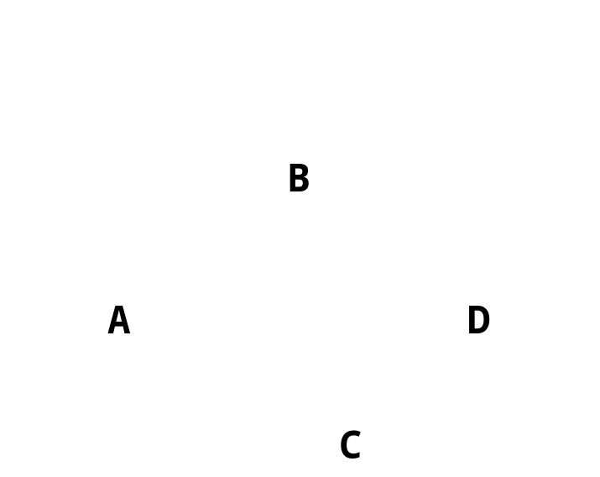
19.7 Trees (cont.)
Fig 19.15 A graphical representation of a binary tree.

Slide 37
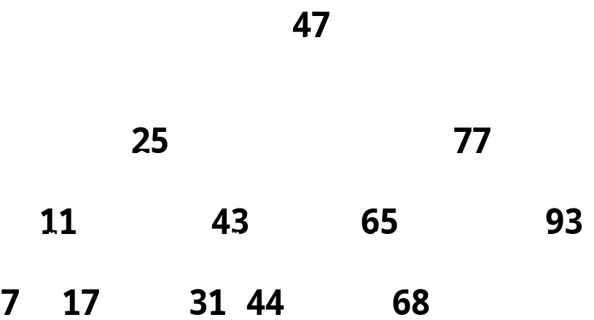
19.7 Trees (cont.)
Fig 19.16 A binary search tree containing 12 values.

Slide 38
Tree.java
Lines 11-13
Lines 27-35
1 // Fig. 19.17: Tree.java
2 // Definition of class TreeNode and class Tree.
3
4 // Deitel packages
5 package com.deitel.jhtp4.ch19;
6
7 // class TreeNode definition
8 class TreeNode {
9
10 // package access members
11 TreeNode leftNode;
12 int data;
13 TreeNode rightNode;
14
15 // initialize data and make this a leaf node
16 public TreeNode( int nodeData )
17 {
18 data = nodeData;
19 leftNode = rightNode = null; // node has no children
20 }
21
22 // insert TreeNode into Tree that contains nodes;
23 // ignore duplicate values
24 public synchronized void insert( int insertValue )
25 {
26 // insert in left subtree
27 if ( insertValue < data ) {
28
29 // insert new TreeNode
30 if ( leftNode == null )
31 leftNode = new TreeNode( insertValue );
32
33 // continue traversing left subtree
34 else
35 leftNode.insert( insertValue );
Left and right children
If value of inserted node is less than value of tree node, insert node in left subtree

Slide 39
Tree.java (Part 2)
Lines 39-48
37
38 // insert in right subtree
39 else if ( insertValue > data ) {
40
41 // insert new TreeNode
42 if ( rightNode == null )
43 rightNode = new TreeNode( insertValue );
44
45 // continue traversing right subtree
46 else
47 rightNode.insert( insertValue );
48 }
49
50 } // end method insert
51
52 } // end class TreeNode
53
54 // class Tree definition
55 public class Tree {
56 private TreeNode root;
57
58 // construct an empty Tree of integers
59 public Tree()
60 {
61 root = null;
62 }
63
64 // Insert a new node in the binary search tree.
65 // If the root node is null, create the root node here.
66 // Otherwise, call the insert method of class TreeNode.
67 public synchronized void insertNode( int insertValue )
68 {
69 if ( root == null )
70 root = new TreeNode( insertValue );
If value of inserted node is greater than value of tree node, insert node in right subtree

Slide 40
Tree.java (Part 3)
Lines 83-96
71
72 else
73 root.insert( insertValue );
74 }
75
76 // begin preorder traversal
77 public synchronized void preorderTraversal()
78 {
79 preorderHelper( root );
80 }
81
82 // recursive method to perform preorder traversal
83 private void preorderHelper( TreeNode node )
84 {
85 if ( node == null )
86 return;
87
88 // output node data
89 System.out.print( node.data + " " );
90
91 // traverse left subtree
92 preorderHelper( node.leftNode );
93
94 // traverse right subtree
95 preorderHelper( node.rightNode );
96 }
97
98 // begin inorder traversal
99 public synchronized void inorderTraversal()
100 {
101 inorderHelper( root );
102 }
103
Preorder traversal – obtain data, traverse left subtree, then traverse right subtree

Slide 41
Tree.java (Part 4)
Lines 105-118
Lines 127-140
104 // recursive method to perform inorder traversal
105 private void inorderHelper( TreeNode node )
106 {
107 if ( node == null )
108 return;
109
110 // traverse left subtree
111 inorderHelper( node.leftNode );
112
113 // output node data
114 System.out.print( node.data + " " );
115
116 // traverse right subtree
117 inorderHelper( node.rightNode );
118 }
119
120 // begin postorder traversal
121 public synchronized void postorderTraversal()
122 {
123 postorderHelper( root );
124 }
125
126 // recursive method to perform postorder traversal
127 private void postorderHelper( TreeNode node )
128 {
129 if ( node == null )
130 return;
131
132 // traverse left subtree
133 postorderHelper( node.leftNode );
134
135 // traverse right subtree
136 postorderHelper( node.rightNode );
137
Inorder traversal – traverse left subtree, obtain data, then traverse right subtree
Postorder traversal – traverse left subtree, traverse right subtree, then obtain data

Slide 42
Tree.java (Part 5)
138 // output node data
139 System.out.print( node.data + " " );
140 }
141
142 } // end class Tree

Slide 43
TreeTest.java
Lines 17-22
Line 26
Line 30
1 // Fig. 19.18: TreeTest.java
2 // This program tests class Tree.
3 import com.deitel.jhtp4.ch19.Tree;
4
5 // Class TreeTest definition
6 public class TreeTest {
7
8 // test class Tree
9 public static void main( String args[] )
10 {
11 Tree tree = new Tree();
12 int value;
13
14 System.out.println( "Inserting the following values: " );
15
16 // insert 10 random integers from 0-99 in tree
17 for ( int i = 1; i <= 10; i++ ) {
18 value = ( int ) ( Math.random() * 100 );
19 System.out.print( value + " " );
20
21 tree.insertNode( value );
22 }
23
24 // perform preorder traveral of tree
25 System.out.println ( "\n\nPreorder traversal" );
26 tree.preorderTraversal();
27
28 // perform inorder traveral of tree
29 System.out.println ( "\n\nInorder traversal" );
30 tree.inorderTraversal();
31
Insert 10 random integers in tree
Traverse binary tree via preorder algorithm
Traverse binary tree via inorder algorithm

Slide 44
TreeTest.java (Part 2)
Line 34
32 // perform postorder traveral of tree
33 System.out.println ( "\n\nPostorder traversal" );
34 tree.postorderTraversal();
35 System.out.println();
36 }
37
38 } // end class TreeTest
Traverse binary tree via postorder algorithm
Inserting the following values:
39 69 94 47 50 72 55 41 97 73
Preorder traversal
39 69 47 41 50 55 94 72 73 97
Inorder traversal
39 41 47 50 55 69 72 73 94 97
Postorder traversal
41 55 50 47 73 72 97 94 69 39

Slide 45
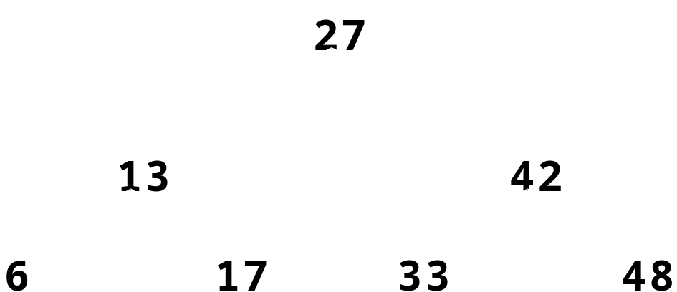
19.7 Trees (cont.)
Fig 19.19 A binary search tree.

